Slide 1




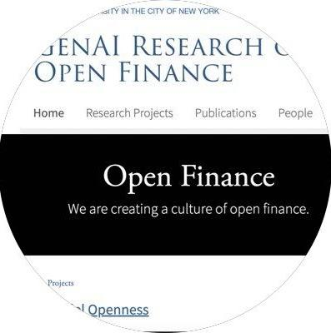





Professional Readiness of LLMs in Financial Regulations?
A Report of Regulations Challenge at COLING 2025
By Keyi Wang, Sarah Huang, Charlie Shen, Kaiwen He, Felix Tian, Jaisal Petel
Supervisors: Christina Dan Wang, Kairong Xiao, Xiao-Yang Liu
Regulations Challenge at COLING 2025
Link: https://coling2025regulations.thefin.ai/home

Slide 2
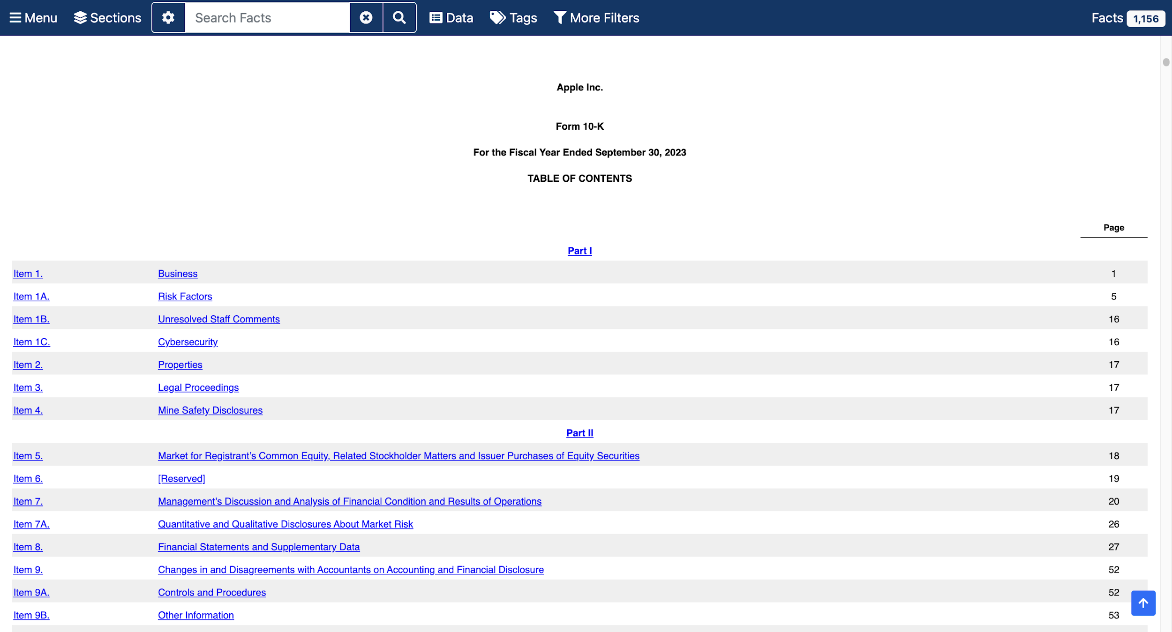
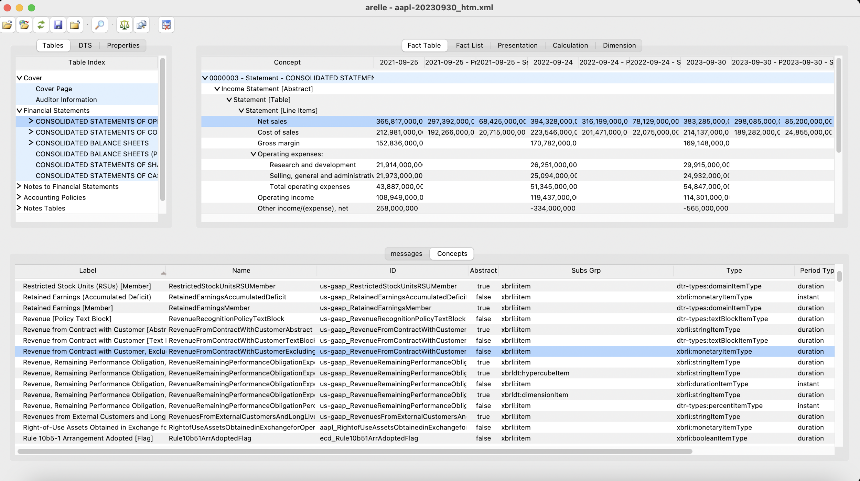
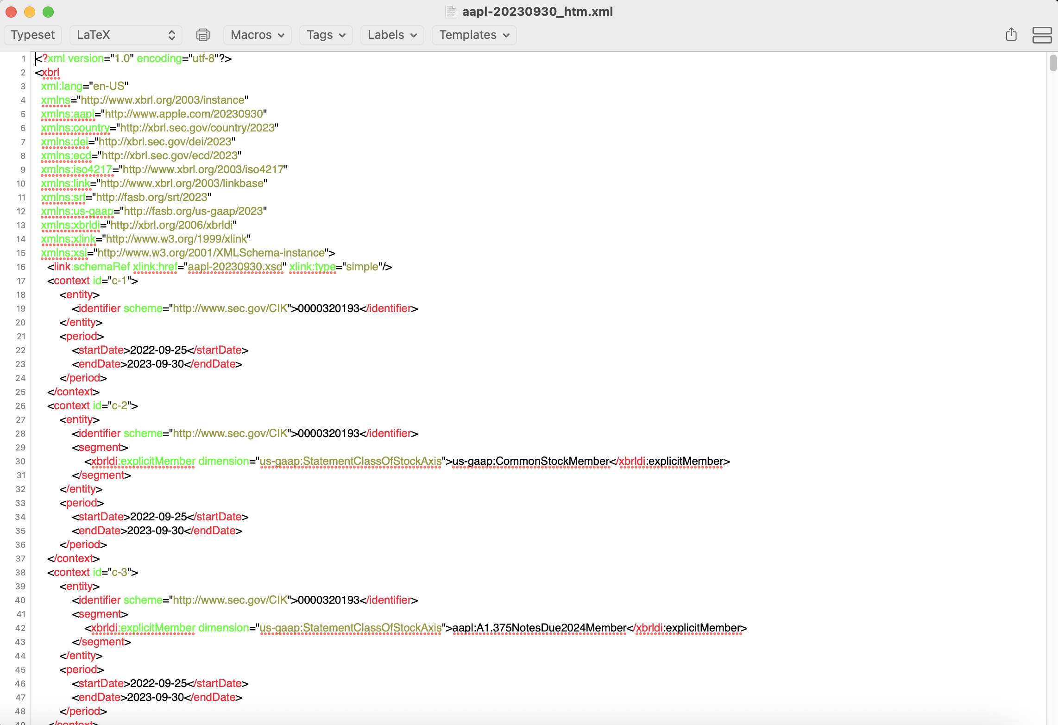
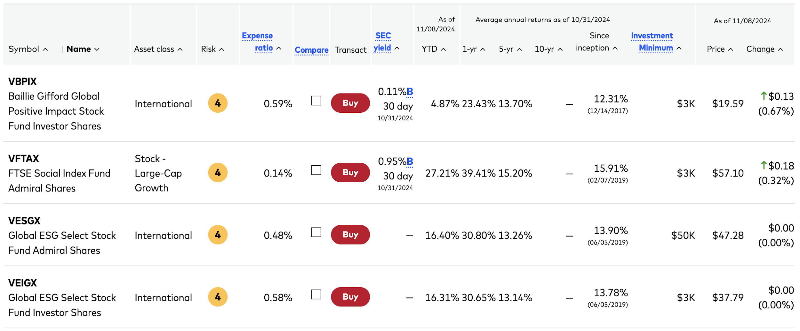
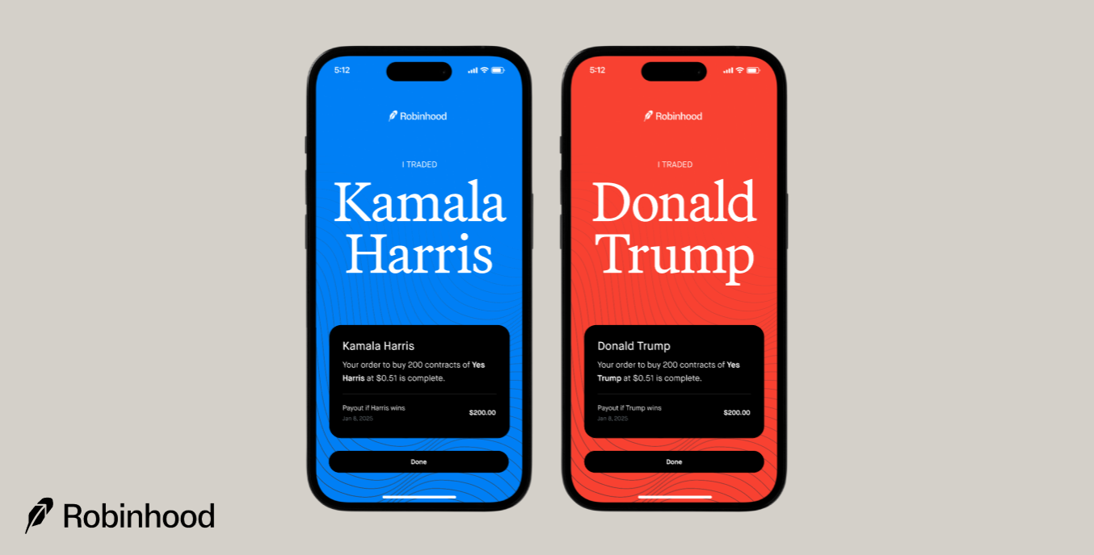


Chatbot Scenarios for Financial Services
Apple Inc.
Form 10-K
For the Fiscal Year Ended September 30, 2023
How did Apple perform last year?
Are XBRL filings compliant?
What is this financial product? How can I invest? What are the risks?
I’m your Warren Buffett assistant.

Slide 3
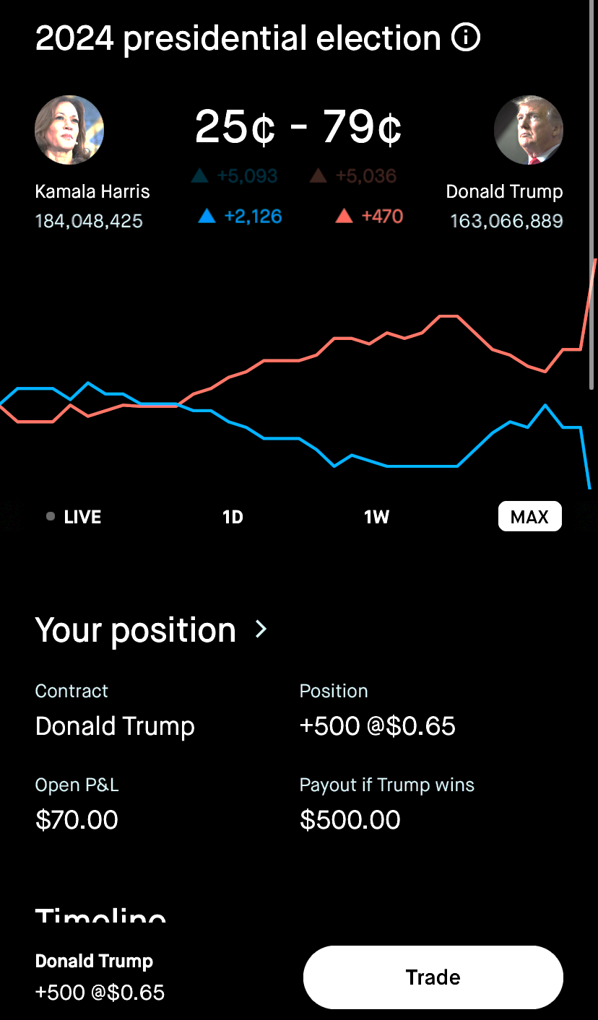





Chatbot Scenarios: Understand Financial Product
What is the Presidential Election Contract?
Where can I buy it?
How to buy it?
Can I bet on both sides?
What are the risks associated with this contract?
How is the market liquidity now?
What are the current odds of betting?
What are the factors that could influence the value of contracts?
Are there any fees or tax implications?
What is the current price trend?
What’s in the current political news regarding the election?
Which candidate should I bet on?
...
I’m your Warren Buffett assistant.
Trade
FAQ
NEWS

Slide 4









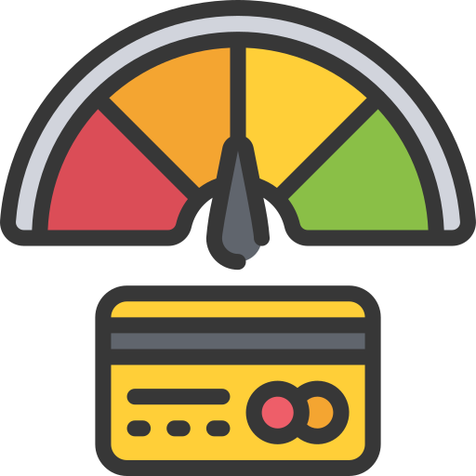

Why Financial Regulation?
Financial Regulation
The financial industry fundamentally relies on binding agreements and obligations, i.e., contracts:
Market sentiment analysis
...
Business contracts
Product and service terms
Regulatory mandates
Financial Industry
Financial report analysis
Fraud detection
Financial regulation and industry standards
Ensure market integrity
Protect investor interests
Mitigate systemic risk
Stock movement prediction
Credit scoring
...
I can help!
Whether existing LLMs achieve professional readiness in financial regulations?

Slide 5
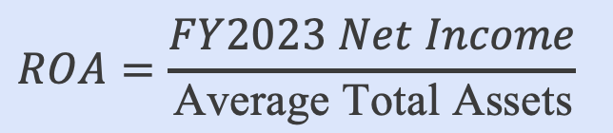

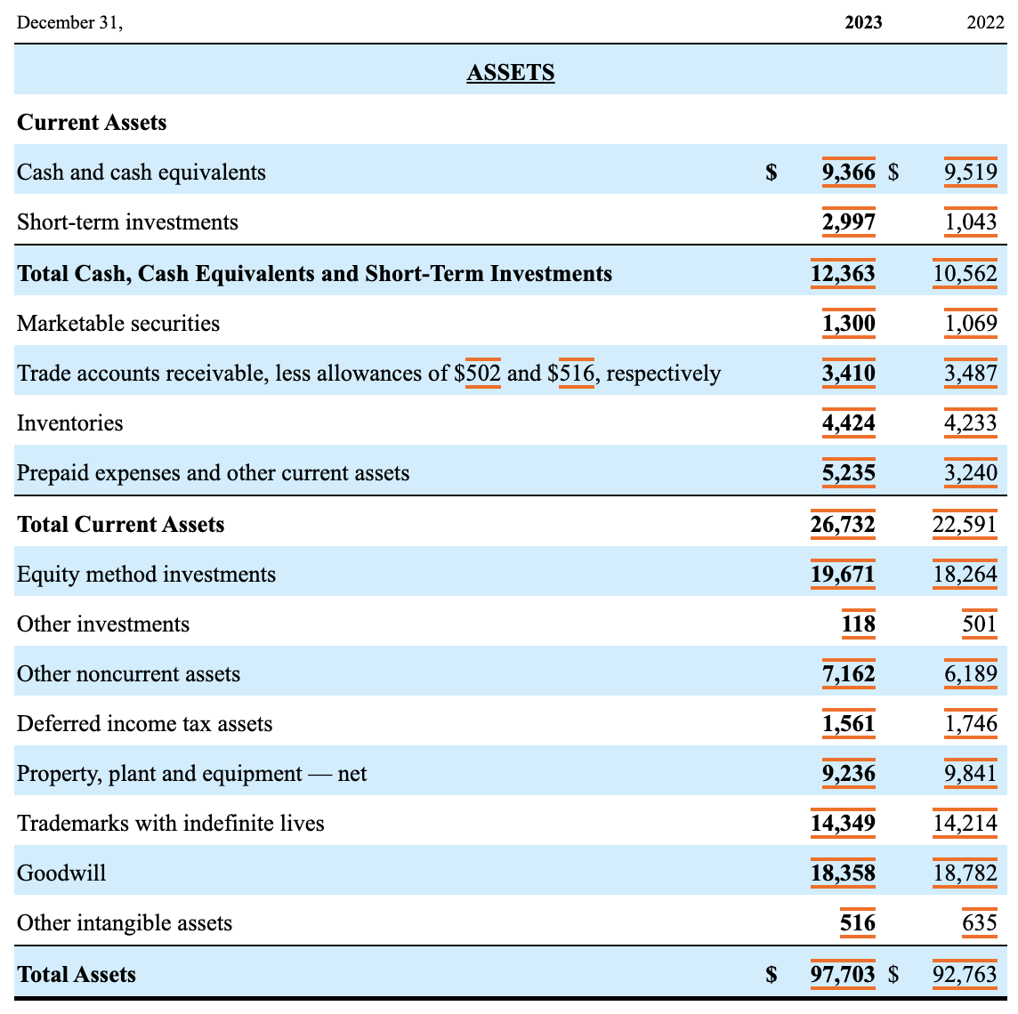
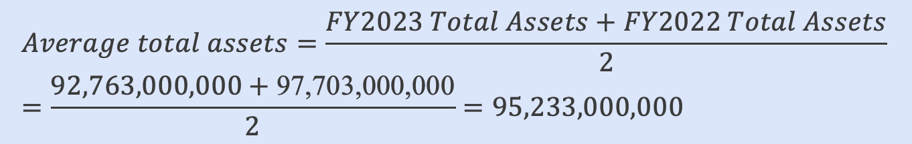

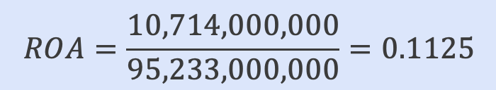
Failure Cases: XBRL Analytics
To determine the Return on Assets (ROA) for Coca-Cola for FY2023, we need to calculate the ROA using the formula:
From the provided XBRL data:
Net Income for FY2023: The net income for FY2023 is given as “us-gaap:NetIncomeLoss” with contextRef="c-1", which is $10,714,000,000.
Average Total Assets:
Total Assets for FY2023: The total assets for 2023 is given as “us-gaap:Assets" with contextRef="c-26", which is $92,763,000,000.
Total Assets for FY2022: The total assets for 2022 is given as "us-gaap:Assets" with contextRef="c-23", which is $97,703,000,000.
We calculate the average total assets as:
Calculate ROA:
Thus, the ROA for Coca-Cola for FY2023 is 11.25%.
I am analyzing Coca Cola’s financial statements. What is the return on assets (ROA) for Coca Cola in 2023?

Slide 6

Professional Readiness in Financial Regulation?
I can help!
Hallucination and misinformation.
Poor performance in financial math.
Lack of details in model’s response.
...
Regulations Challenge @ COLING 2025
Objective
Challenge the academic community to identify the strengths and limitations of LLMs in the context of financial regulation.
To raise awareness of the professional readiness of LLMs.
A Suite of 9 Tasks
Benchmark Datasets
Contestants
Regulatory text interpretation
Data retrieval
Scenario-based analysis and application
...
Regulatory filings
Official documents from important regulatory agencies
...
18 teams from academia and industry.

Slide 7
Regulations Challenge @ COLING 2025
Category | Tasks | Assess LLMs’ ability to | Example
Basic Capabilities | Abbreviation Recognition | recognize acronyms and stock tickers from financial regulatory texts. | IPO – Initial Public Offering ICO – Initial Coin Offering
 | Definition Recognition | define terms and phrases used in financial regulatory and compliance documentation. | Stakeholder – a party who has an interest and might be affected by the performance and outcome of an entity’s business, project, or enterprise.
 | Named Entity Recognition (NER) | identify and classify entities in a statement about financial regulation. | Regulation (EU) No 648/2012 of the European Parliament and of the Council of 4 July 2012 on OTC derivatives, central counterparties and trade repositories (“EMIR”) entered into force on 16 August 2012.
 | Question Answering | answer questions about financial regulations accurately. | How do Basel III regulations, including the FRTB, aim to enhance market stability?
 | Link Retrieval | retrieve and provide the exact link to specific regulations. | Regulation (EU) 2019/834 -- https://eur-lex.europa.eu/eli/reg/2019/834/oj
Passing Certificate | Certificate Question | pass CFA and CPA exams | Phil Jones, CFA,... is about to issue an unfavorable report on the company. His manager does not want him to state any adverse opinions...
XBRL Analytics | XBRL Analytics | interpret, and analyze XBRL filings | What is the value of Walt Disney Co's Total Assets for the Fiscal Year ending in FY 2023?
CDM | CDM | answer questions related to the Common Domain Model | How is the TradeState data type utilized to track changes in a trade's lifecycle in the Common Domain Model?
MOF | MOF Licenses | answer questions about the licensing requirements outlined in MOF | What licenses are recommended for Model Parameters under the Model Openness Framework?

Slide 8
Testing Dataset
Category | Domain | Task | Size | Data sources
EMIR | European OTC derivative market | Abbreviation (115), Definition (50), NER (49), Link Retrieval (100) | 314 | EUR-LEX, ESMA
SEC statutes and regulations | US securities market | Abbreviation (76+3298), Definition (13), QA (19), Link Retrieval (18) | 126 + 3298 (stock tickers) | SEC
Federal Reserve regulations | US banking system | Abbreviation (44), Definition (100), QA (107), Link Retrieval (16) | 267 | Federal Reserve
GAAP | Accounting and auditing | Abbreviation (50), Definition (30), QA (50) | 130 | FASB
Certificate | Ethics and regulations | Certificate Question | 346 | CFA, CPA exam
XBRL | XBRL | XBRL Analytics | 1700 | FinanceBench, XBRL reports, XBRL website
CDM | CDM for financial product management | CDM | 99 | CDM docs
MOF Licenses | MOF | MOF Licenses | 161 | OSI website MOF docs

Slide 9
Regulations Challenge @ COLING 2025
Challenge the academic community to explore the strengths and limitations of LLMs in the context of financial regulations and industry standards.
Better understand the hallucination and misinformation problems of LLMs in financial regulations.
Help raise awareness of the professional readiness of LLMs in financial regulation.

